Slide 1

From AI to EI - Integrating Five Types of Intelligence to Achieve Organizational Excellence
MakeLearn & TIIM International Conference, May 15-17, 2019, Piran, Slovenia
Chaojie (Jay) Wang, The MITRE Corporation, USA*
Fred Hoffman, Fifth Domain Solutions LLC, USA
Alvi Lim, The MITRE Corporation, USA*
Jin Kwon, Robert Morris University, USA
2019.05
* The author's affiliation with The MITRE Corporation is provided for identification purposes only and is not intended to convey or imply MITRE's concurrence with, or support for, the positions, opinions, or viewpoints expressed by the author. Approved for Public Release; Distribution Unlimited. Case Number 19-1398. ©2019 The MITRE Corporation. ALL RIGHTS RESERVED.

Slide 2
Agenda
1. Introduction to the A2E Model
2. Application of the A2E Model

Slide 3
1. Introduction to the A2E Model

Slide 4
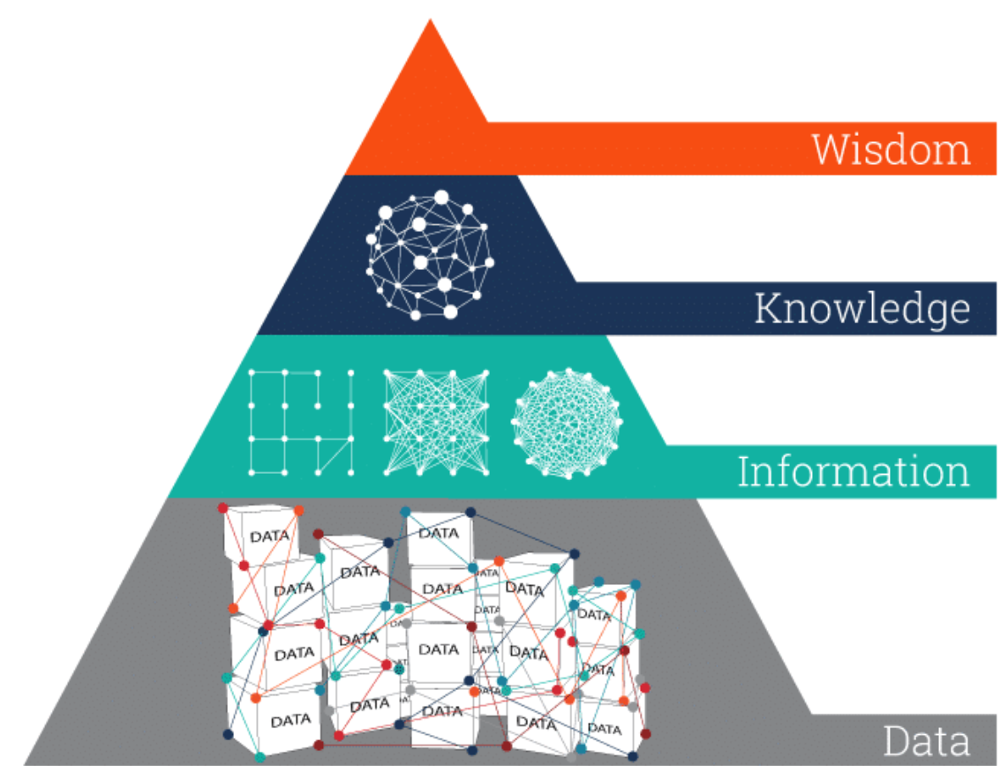
Theoretical Foundation: 1. DIKW Hierarchy (Zeleny, 2006)
knows why
knows how
knows what
knows nothing
Image adapted from: https://www.ontotext.com/knowledgehub/fundamentals/dikw-pyramid/
Zeleny, M. (2006). From knowledge to wisdom: On being informed and knowledgeable, becoming wise and ethical. International Journal of Information Technology & Decision Making, 5(04), 751-762.

Slide 5
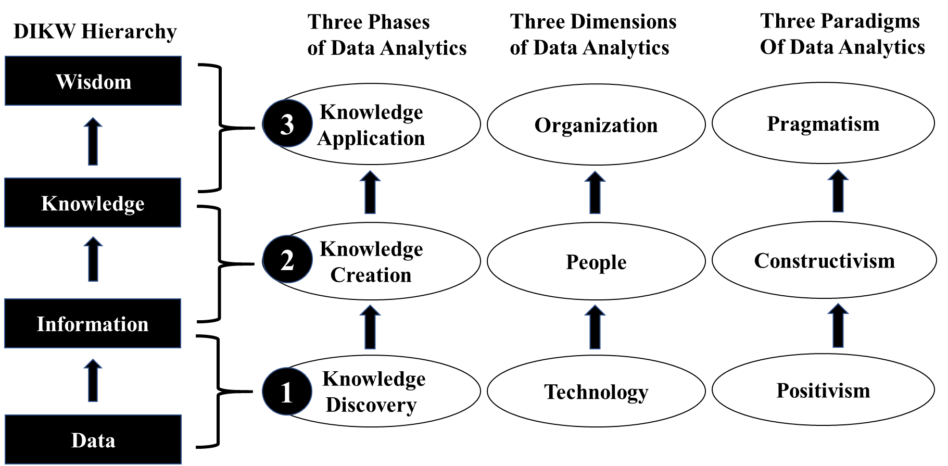
Theoretical Foundation: 2. Data Analytics Process Model (Wang, 2018)
Wang, C. (2018). Integrating data analytics & knowledge management: A conceptual model. Issues in Information Systems, 19(2), 208-216.

Slide 6
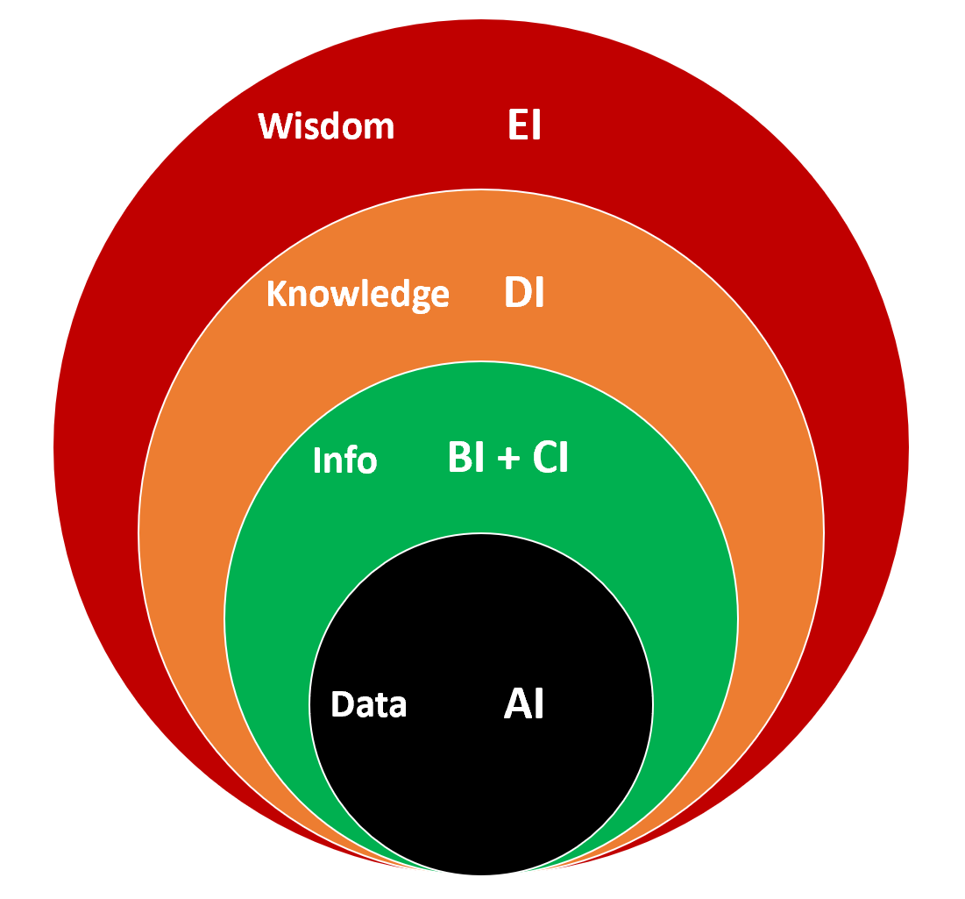
The Integrative Intelligence Model (A2E Model)
Artificial intelligence (AI)
Data analysis & decision support tool
Business intelligence (BI)
Intelligence gathering within the organization
Competitive intelligence (CI)
Intelligence gathering from the market & environment
Decision intelligence (DI)
Evidence-based rational decision making
Emotional intelligence (EI)
Let your heart guide your brain

Slide 7
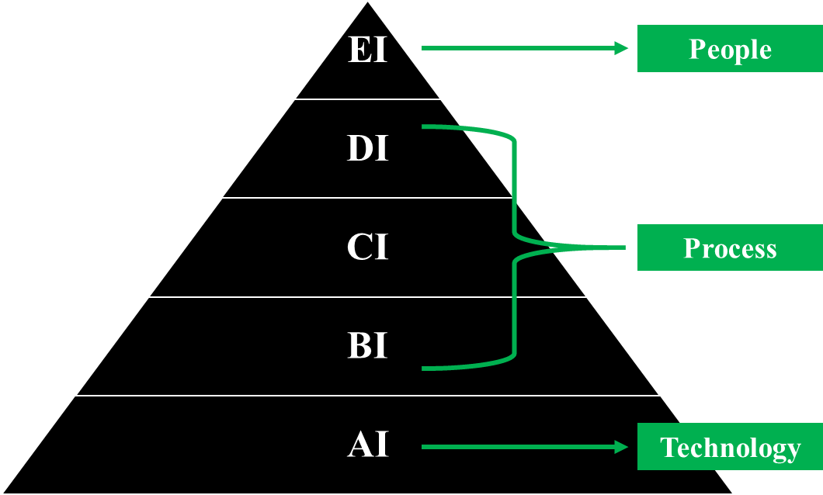
A2E Model In the Context of People-Process-Technology
AI belongs to the technology domain and represents tools and techniques
BI/CI/DI belong to the process domain and represent the process of data collection, analysis, collaboration, and decision making
EI belongs to the people domain and represents the value proposition and belief system

Slide 8
2. Application of the A2E Model

Slide 9

Victims of the Online Retail Phenomenon
2013: Best Buy in a free fall
2015: RadioShack declared bankruptcy after 94 years
2018: Sears filed for bankruptcy
2019: Analysts predict JCPenney will likely file for bankruptcy this year

Slide 10
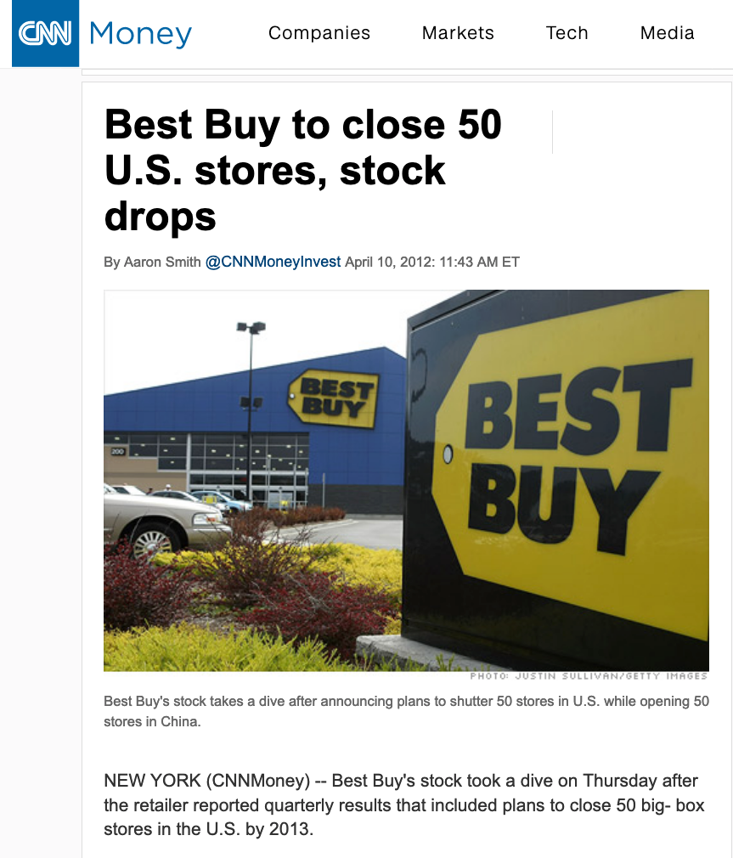
Best Buy in 2012
CEO resigned after admitting to improper relationship with an employee
Employee engagement, retention, and morale were terrible
Company revenue, stock prices were in steady decline
Company announced it would be closing 50 stores
Best Buy stores were losing money as customers increasingly bought online

Slide 11
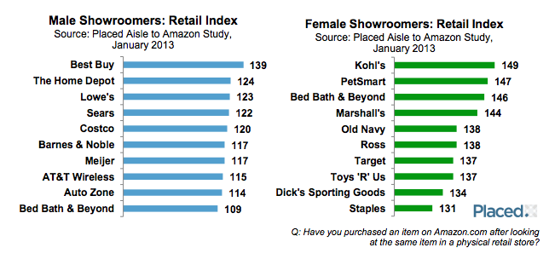
Showrooming
Showrooming = The act of browsing brick-and-mortar stores and then later making the purchase online, often at a cheaper price.
A common response to showrooming has been price matching—which puts retail stores at a disadvantage because of their overhead.
Survey Question: “Have you purchased an item on Amazon.com after looking at the same item in a physical retail store?”
Notes:
https://www.geekwire.com/2013/amazon-placed-brick-mortar-retailers/

Slide 12
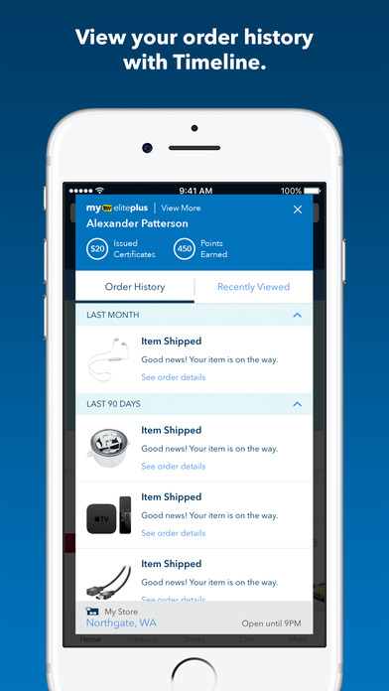
A2E Integrated Intelligence: Best Buy Case (AI)
Artificial Intelligence (AI)
Best Buy mobile phone applications
Walk into a Best Buy store and the app enters ‘local store’ mode
sends relevant push notifications
tailors the experience to that location’s inventory
On My Way feature lets sales associates know when someone is on their way to pick up an online order

Slide 13
A2E Integrated Intelligence: Best Buy Case (BI)
Notes:
CEO Hubert Joly
Transformed corporate culture
Invested in employee training
Improved their work/life balance
Took steps to improve loyalty and retention (employee discount program)
Improved organizational efficiency
Turned individual stores into mini-distribution hubs; a local store might have an item the regional distribution warehouse might not
Built customer loyalty
Price matching program
Created branded product spaces for companies to essentially rent out
Offered “pick-it-up” or “ship it” options
http://digitalmarketing.temple.edu/sglose/2019/03/06/saving-best-buy-combining-emotional-intelligence-with-business-intelligence/

Slide 14
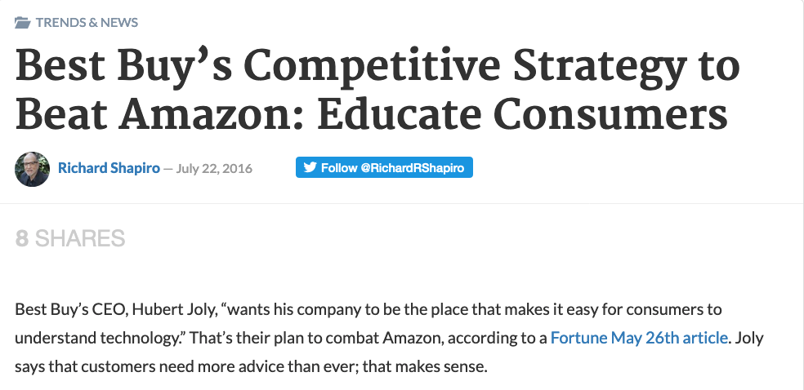
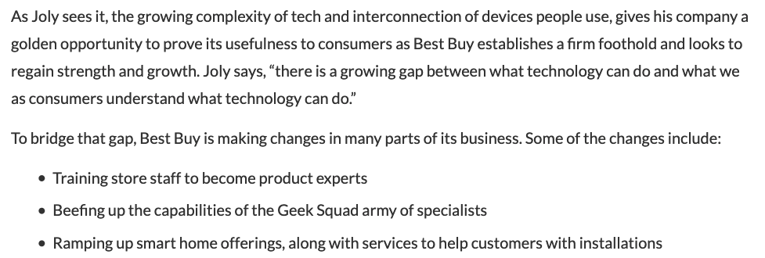
A2E Integrated Intelligence: Best Buy Case (CI)
Competitive Intelligence (CI)
Who are my competitors?
How are they responding to the online retail threat?
What are they doing that’s working?
What are they doing that’s failing?
How can Best Buy differentiate itself from our competitors and
Earn customer loyalty
Make us their “go-to” choice?

Slide 15
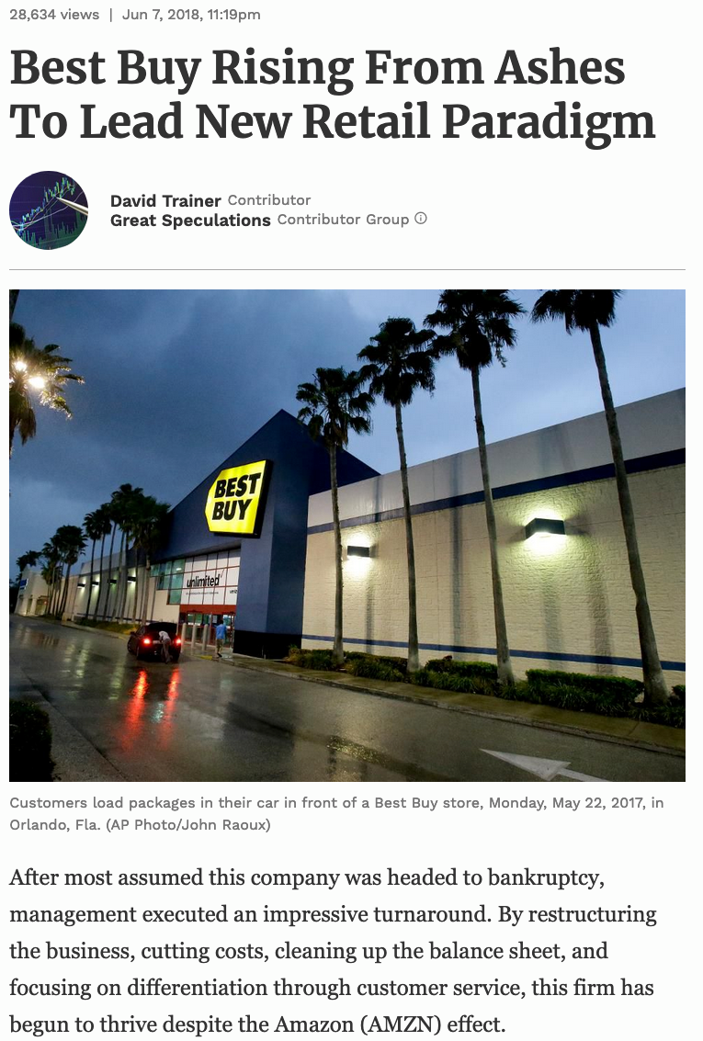
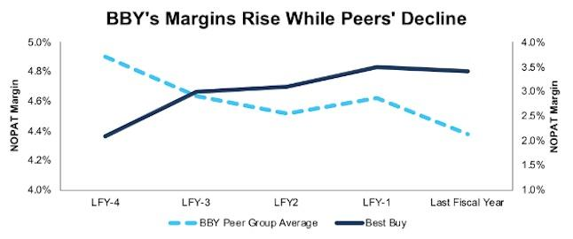

A2E Integrated Intelligence: Best Buy Case (DI)
Decision Intelligence (DI)
Drawing upon both tacit and explicit knowledge to make decisions
AI, BI, CI: Mainly explicit knowledge
KM: Both tacit & explicit knowledge
RESULT: Price-matching, but only accepting short-term $$$ loss to buy time to:
Build employee morale
Gain customer trust
Give customers a reason to turn to Best Buy as their “go-to” choice

Slide 16
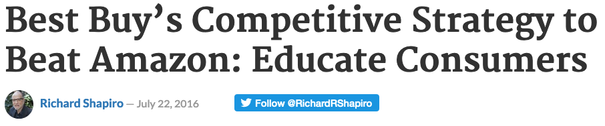
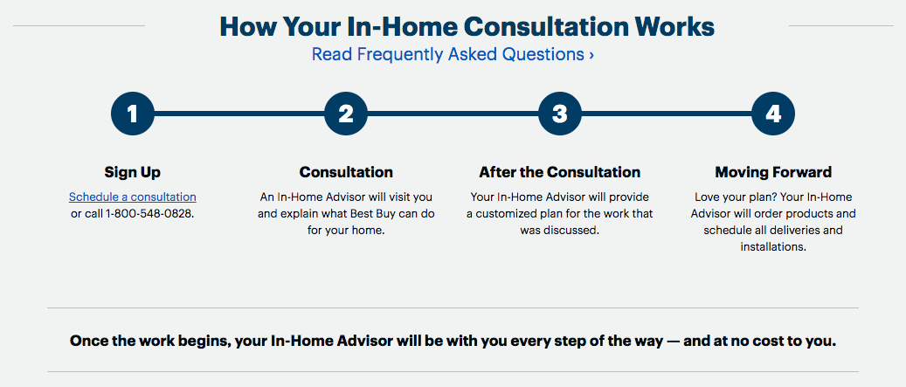
A2E Integrated Intelligence: Best Buy Case (EI)
CEO Hubert Joly based strategy on the human connection – both internally & externally
Internally:
Boosted employee morale
Transformed corporate culture
Externally:
Improved customer loyalty through multi-level customer engagement
Try-before-you-buy
Geek Squad (installation)
In-Home Consultation (advisors)
Notes:
CEO Hubert Joly emphasized the human connection
Trained employees to be empathetic and supportive to customers – by first being empathetic and supportive to his employees
Made more employees salaried, rather than hourly
Did not punish them for failing to make sales
Encouraged them to cultivate customer relationships (“here’s my card”)
Treating employees better translated into:
Higher employee retention
Happier, more content employees
Better employess-customer interaction
Increased sales
Personal engagement vs the anonymity of online shopping experience
Geek Squad and In-Home Advisor programs form personal relationships with customers
become a “go-to” person to call with questions/concerns
Preferable to chatbots and outsourced overseas call centers
http://digitalmarketing.temple.edu/sglose/2019/03/06/saving-best-buy-combining-emotional-intelligence-with-business-intelligence/

Slide 17
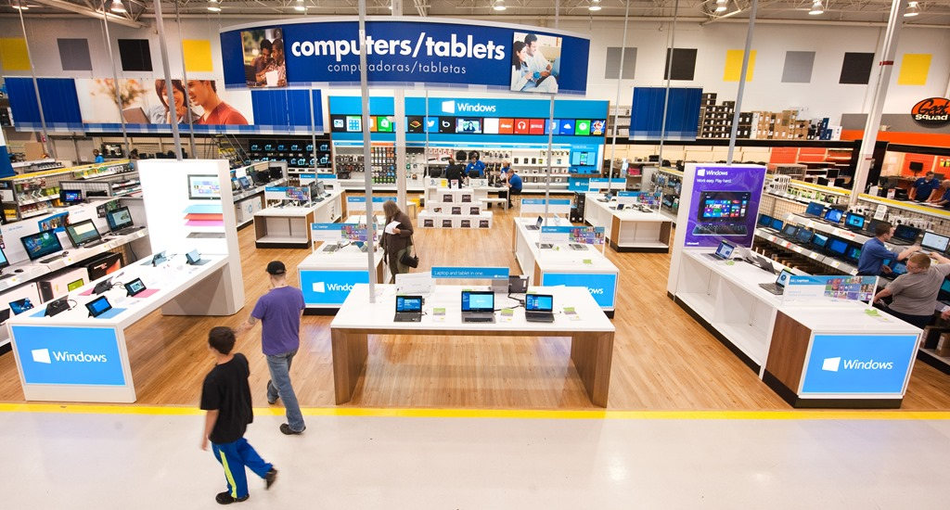
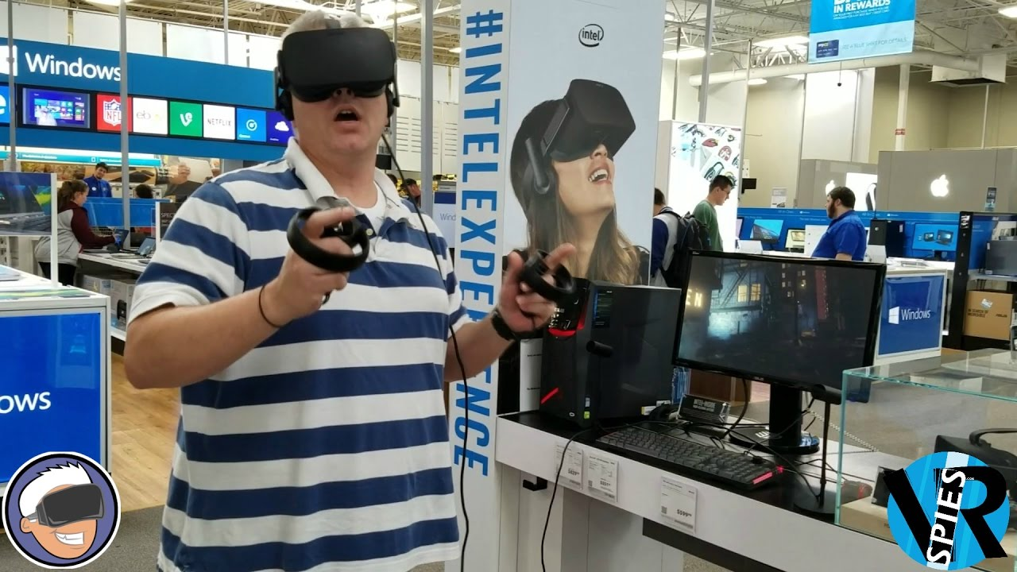
Best Buy Transformed
Best Buy formed strategic partnerships with Microsoft, Apple, Google, Samsung, and other manufacturers; prominent areas of the store are dedicated to their products
Sales staff are adequately knowledgeable about those products
Emphasis is now on educating & advising the customer
The “Try-Before-You-Buy” Experience
Notes:
June, 2013: Best Buy announces “the Windows Store” at 500 Best Buy locations in the US and 100 in Canada
Dedicated spaces ranging from 1,500-2,200 sq feet
Staff trained to help customers try, compare, and purchase products and accessories
People very much still prefer the hands-on experience when it comes to technology and there’s only so much detail you can get from a website.

Slide 18

Take-aways
Technology—the double-edged sword
Man creates technology to solve problem
BUT: technology creates both opportunities and threats
Application of technology requires a holistic strategy
The A2E Model—the power of simplicity
Builds upon knowledge management and data analytics
Leverages and integrates explicit and tacit knowledge
Leverages and unifies technology and humanity
The Power of Simplicity

Slide 19
Chaojie (Jay) Wang
Fifth Domain Solutions LLC, USA
Alvi Lim
The MITRE Corporation, USA
Jin Kwon
Robert Morris University, USA
Fred Hoffman
The MITRE Corporation, USA
cjwang@mitre.org
f.hoffman@fifthdomainsolutions.com
jhkst187@mail.rmu.edu
alim@mitre.org

